Slide 1
AVERT
All Valuable Electronics Restart Time
Tracy Fu, Tommy Murray, Matthew Palermo, Collin Strauch
Notes:
You can change the theme/layout of these slides, but please keep the content, number of slides, and order the same!

Slide 2
Team Info
Mission Statement
The main goal with creating this game, classwork aside, is that we wanted to make a decent portfolio piece. In the game development industry, it is vital to have a stellar portfolio. If this class project would be considered a strong enough piece of work to place on to a portfolio, then it would be very helpful. Since this is the first group project that requires coding we all worked on, we also wanted to have something we could look back on and see how we can change what we implemented for the future.
Tracy Fu - OO Development, OO Design
Tommy Murray - Asset production, UI Designer
Matthew Palermo - Version Control Master, OO Design
Collin Strauch - External Tool Development, OO Development

Slide 3
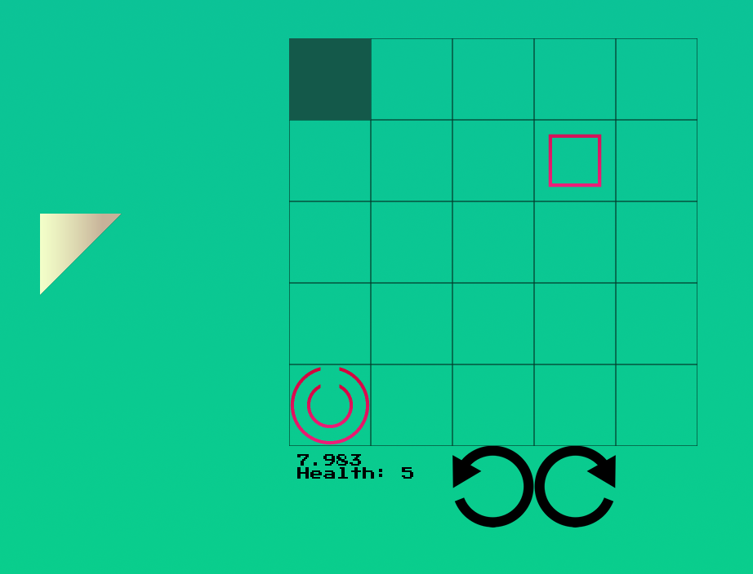
AVERT
Shoot the target with your laser. In order to do so, you have to place a mirror into a grid, which can be rotated at will. Hit the target to clear the level!
Notes:
For the summary, keep it VERY brief and player-focused. A 2-3 sentence summary meant to peak a player’s interest.

Slide 4
Key Features
The game is in fullscreen. The player can move from one screen to another using the keys. The specified key is in parentheses.
When the player clears a level, they are told what their score is.
The player can play any of the 5 levels, and edit them as they want from the external tool level editor.
The player fails the level if they miss the target or run out of time.
The mirror can be clicked and dragged into the grid, and rotated by clicking the rotation icons.

Slide 5
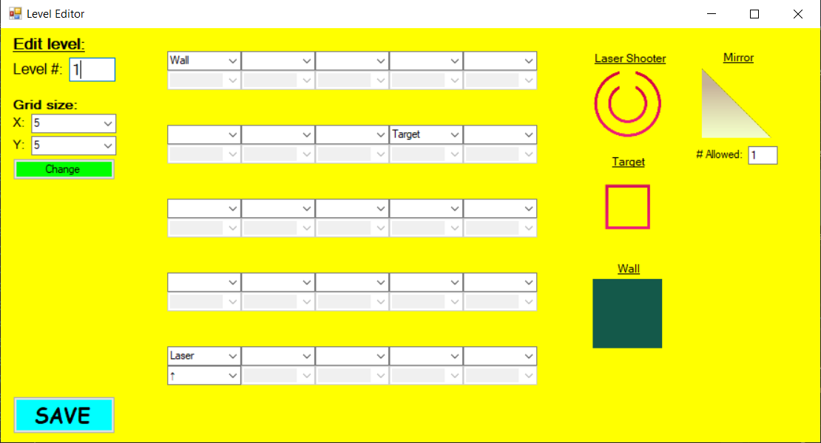
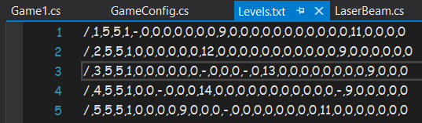
External Tool
This is the Windows UI External tool. It allows the user to customize the number of rows and columns in any level of their choice. They can also edit how many mirrors they are given, as well as editing any part of the grid to hold a target, wall, and the laser shooter. When the user is finished editing the level, it saves to a .txt file after the player clicks save.

Slide 6
OO Lessons Learned
MonoGame’s Game1 class is used for the key functions (drawing, updating, and user input).
Each shape has a parent class in their own way. If a shape can be moved into the grid, it has a moveable shape parent. If the shape starts already inside the grid, it has a stable shape class.
GameConfig is used to load the file when it contains data from the external tool.

Slide 7
Production Lessons Learned
Time management is super important. Almost all of the game’s required functions were implemented near the end of the due date, which causes stress.
Task management. If a Trello board is made, it should not be completely foregone. People should be updating and checking it regularly.
Working 100% remotely still requires everyone to be fully involved in the game production. It can be easy to procrastinate due to the different work environment, but realizing that the project is still happening should make everyone be certain that they still have work to do.

Slide 8
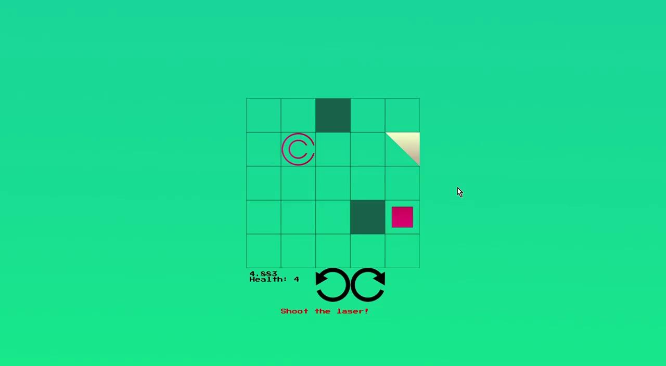
Demo Video
Notes:
Include 1-2 minutes (max!) of video capture of your game. No need for voice overview unless you want to. The idea is to capture enough for the viewer to get a sense of the state of your game. Show whatever parts you think are the most interesting.
No need to show the external tool in use.
There are a lot of options for capturing game play video.
https://support.microsoft.com/en-us/help/4027180/windows-10-record-a-game-clip-with-xbox-game-bar
https://obsproject.com/
Shadowplay
Ask for help if you need it!
Once you have a video, upload it to Google Drive, set the access to “anyone within the RIT organization can view”, and embed it into this slide.
To insert the video into the slides, see: https://support.google.com/docs/answer/97447

